Slide 1
MODULE-IV
Annotations and JDBC
By:
Shivakumara T
Assistant Professor,
Department of MCA,
BMSITM, Bangalore- 560064

Slide 2
The following Topics will be discussing in this Module
Built-in Annotations with examples
custom annotation
Talking to Database
Immediate Solutions
Essential JDBC program
using prepared Statement Object
Interactive SQL tool
8. JDBC in Action
9. Result sets
10. Batch updates
11. Mapping,
12. Basic JDBC data types
13. Advanced JDBC data types
14. immediate solutions

Slide 3
Built-in Annotations with examples
Annotation
Annotations are metadata or data about data. An annotation indicates that the declared element should be processed in some special way by a compiler, development tool, deployment tool, or during runtime.
Annotation-based development is certainly one of the latest Java development trends
Annotations can be applied to several Java Elements like,
  package declarations,
  class,
  constructors,
  methods,
  fields,
  Variables and etc.

Slide 4
Built-in Annotations with examples
Annotation
The goal: Allow the programmer to provide additional information about the program – This information can be used by software engineering tools
• An annotation is a type – defined using an interface-like syntax
• An annotation can be specified whenever a modifier is allowed – Convention: before the public/static modifiers
• Annotations do not affect semantics of the class – But may affects semantics of things using the class (tools, code generation, runtime options, etc.)

Slide 5
Built-in Annotations with examples
The Basics
Example to Define an Annotation (Annotation type)
  public @interface MyAnnotation {
    String doSomething();
    }
Example to Annotate Your Code (Annotation)
  MyAnnotation (doSomething="What to do")
  public void mymethod() {
  .......
  }

Slide 6
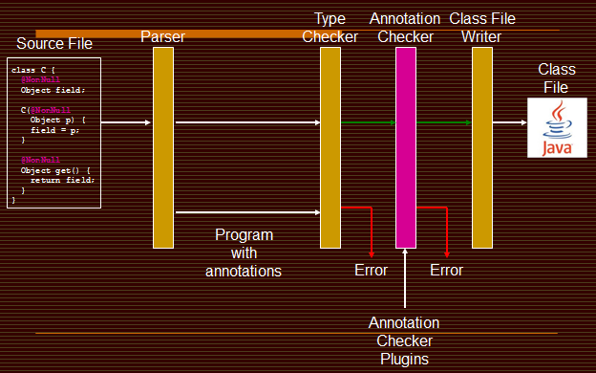
Structure of Java5 Compiler

Slide 7
custom annotation
Predefined Annotations
• @Override – Assert intention to override a method in a superclass – Compiler fails if not actually overriding
• Checks spelling, override vs. overload
• @Deprecated – Indicates that an element should not be used
• @SuppressWarning – Tells the compiler to suppress specific warnings

Slide 8
Annotation Types
Marker
Single-Element
Full-value or multi-value

Slide 9
Marker
Marker annotations take no parameters. They are used to mark a Java element to be processed in a particular way.
Example:
public @interface MyAnnotation {
}
Usage:
  @MyAnnotation
  public void mymethod() {
  ....
  }

Slide 10
Single-Element
Single-element, or single-value type, annotations provide a single piece of data only. This can be represented with a data=value pair or, simply with the value (a shortcut syntax) only, within parenthesis.
Example:
    public @interface MyAnnotation {
    String doSomething();
    }
Usage:
    @MyAnnotation ("What to do")
    public void mymethod() {
    ....
    }

Slide 11
Full-value or multi-value
Full-value type annotations have multiple data members.
Example:
  public @interface MyAnnotation {
  String doSomething();
  int count;
  String date();
  }
Usage:
@MyAnnotation (doSomething=
"What to do",
count=1,
date="09-09-2005")
public void mymethod() {
.... }

Slide 12
The Built-In Annotations
Java defines seven built-in annotations.
Four are imported from java.lang.annotation
    @Retention,
    @Documented,
    @Target,
    and @Inherited.
Three are included in java.lang.
  @Override,
  @Deprecated,
  and @SuppressWarnings.

Slide 13
Simple Annotations (or) Standard Annotations
There are three types of simple annotations provided by JDK5. They are:
  Override
  Deprecated
  Suppresswarnings

Slide 14
Override
Override is a Marker Annotation type that can be applied to a method to indicate to the Compiler that the method overrides a method in a Superclass. This Annotation type guards the programmer against making a mistake when overriding a method. For eg The syntax ---@Override
Example Program:
class Parent {
public float calculate (float a, float b) {
return a * b;
}
}
Whenever you want to override a method, declare the Override annotation type before the method:
public class Child extends Parent {
@Override
public int calculate (int a, int b) {
return (a + 1) * b;
}
}

Slide 15
The Deprecated annotation
This annotation indicates that when a deprecated program element is used, the compiler should warn you about it. Example 2 shows you the deprecated annotation.
The syntax --- @Deprecated
Example :
public class DeprecatedTest {
@Deprecated
public void serve() {
}
}
If you use or override a deprecated method, you will get a warning at compile time.
public class DeprecatedTest2 {
public static void main(String[] args) {
DeprecatedTest test = new DeprecatedTest();
test.serve();
}
}

Slide 16
The Suppresswarnings annotation
SuppressWarnings is used to suppress compiler warnings. You can apply @SuppressWarnings to types, constructors, methods, fields, parameters, and local variables.
The syntax --- @SuppressWarnings
Eg:
  import java.util.Date;
  public class Main {
  @SuppressWarnings(value={"deprecation"})
  public static void main(String[] args) {
  Date date = new Date(2009, 9, 30);
  System.out.println("date = " + date);
  }
  }

Slide 17
Documentation
public class Generation3List extends {
  // Author: John Doe
  // Date: 3/17/2002
  // Current revision: 6
  // Last modified: 4/12/2004
  // By: Jane Doe
  // Reviewers: Alice, Bill, Cindy
  // class code goes here
}
  @ClassPreamble (
    author = "John Doe",
    date = "3/17/2002",
    currentRevision = 6,
    lastModified = "4/12/2004",
    lastModifiedBy = "Jane Doe",
    reviewers = {"Alice", "Bob", "Cindy"}
  )
Using Java Annotation
  @Documented
  @interface ClassPreamble {
    String author();
    String date();
    int currentRevision() default 1;
    String lastModified() default "N/A";
    String lastModifiedBy() default "N/A";
    String[] reviewers(); }

Slide 18
The Target annotation
@Target(ElementType.TYPE)—can be applied to any element of a class
@Target(ElementType.FIELD)—can be applied to a field or property
@Target(ElementType.METHOD)—can be applied to a method level annotation
@Target(ElementType.PARAMETER)—can be applied to the parameters of a method
@Target(ElementType.CONSTRUCTOR)—can be applied to constructors
@Target(ElementType.LOCAL_VARIABLE)—can be applied to local variables
@Target(ElementType.ANNOTATION_TYPE)—indicates that the declared type itself is an

Slide 19
JDBC Object
Practically every J2EE application saves, retrieves, and manipulates
information stored in a database using web services provided by a
J2EE component.
A J2EE component supplies database access using
Java data Objects contained in the JDBC application
programming interface (API).
Java data objects have methods that open a connection to a
database management system (DBMS) and then transmit
messages (queries) to insert, retrieve, modify or delete data
stored in a database.
Shivakumara Tuppad, Asst. Professor, Dept. of MCA, BMSIT

Slide 20
The Concept of JDBC:
One of the major obstacles for Sun Microsystems, Inc. to Overcome was a language barrier.
Each DBMS defined its own low-level way to interact with programs to access data stored in its databases.
This meant low-level code written to communicate with an Oracle database might need
To be rewritten to access a DB2.
Shivakumara Tuppad, Asst. Professor, Dept. of MCA, BMSIT

Slide 21
The JDBC driver developed by Sun Microsystems, Inc. wasn’t a driver at all. It was a specification that described the detail functionality of a JDBC driver.
The specifications required a JDBC driver to be a translator that converted low-level proprietary DBMS messages to low-level messages understood by the JDBC API, and Vice versa.
Java programmers could use high-level Java Data Objects defined in the JDBC API to write a routine that interacted with the DBMS.
Shivakumara Tuppad, Asst. Professor, Dept. of MCA, BMSIT

Slide 22
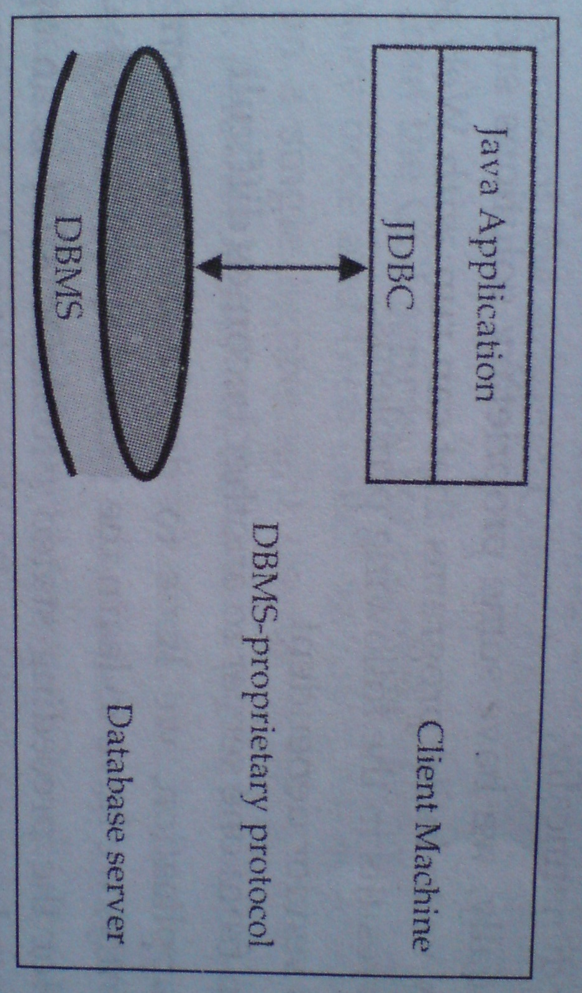
JDBC 2-tier Architecture

Slide 23
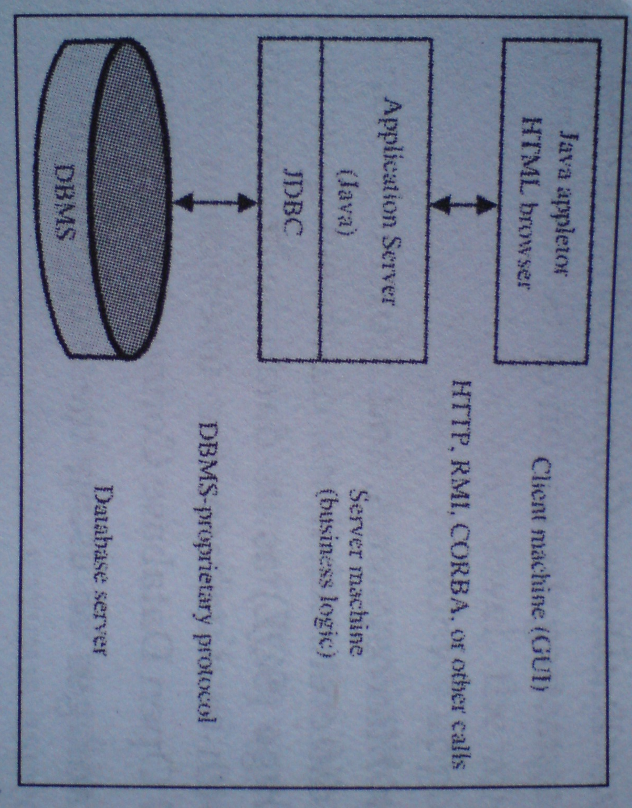
JDBC 3-tier Architecture

Slide 24
JDBC Driver types:
JDBC driver specification classifies JDBC drivers into four groups. Each group is referred to as a JDBC driver type.
Type1 JDBC-to-ODBC Driver:
Also called the JDBC/ODBC Bridge, is used to translate DBMS calls between the JDBC specification and ODBC specification.
The JDBC-to-ODBC driver receives messages from J2EE component that conforms to the JDBC specification.
Shivakumara Tuppad, Asst. Professor, Dept. of MCA, BMSIT

Slide 25
Those messages are translated by the JDBC-to-ODBC driver into the ODBC message format, which is then translated into the message format understood by the DBMS
Imp. Note:
Avoid using the JDBC/ODBC bridge in a mission-critical application because the extra translation might negatively impact performance
Shivakumara Tuppad, Asst. Professor, Dept. of MCA, BMSIT

Slide 26
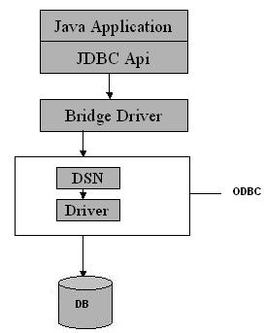
Type 1 JDBC Driver/JDBC-ODBC Bridge driver

Slide 27
Type 2 Java/Native code Driver:
This driver uses Java classes to generate platform-specific code - i.e., code only understood by a specific DBMS.
The manufacturer of the DBMS provides both the Java/Native Code driver and API classes so the J2EE component can generate the platform- specific code.
Imp. Note:
Disadvantage of this driver is the loss of some portability of code. The API classes for this driver probably won’t work with another manufacturer’s DBMS.
Shivakumara Tuppad, Asst. Professor, Dept. of MCA, BMSIT

Slide 28
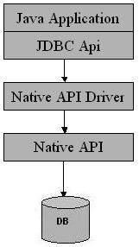
Type 2 JDBC Driver/Native-API/partly Java driver

Slide 29
Examples of Type -2 Driver
OCI(Oracle Call Interface) Driver
Web logic OCI Driver for oracle
Type -2 driver for Sybase

Slide 30
Type 3 JDBC Driver:
It is also referred to as the Java Protocol, is the most commonly used JDBC driver.
It converts SQL queries into JDBC-formatted statements.
The JDBC-formatted statements are translated into the format required by the DBMS.
Examples of Type -3 Driver
IDS Driver
Weblogic RMI Server
Shivakumara Tuppad, Asst. Professor, Dept. of MCA, BMSIT

Slide 31
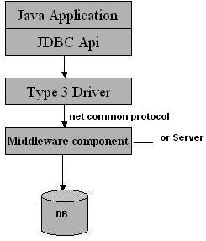
Type 3 JDBC Driver/All Java/Net-protocol driver

Slide 32
Type 4 JDBC Driver:
This is also known as the Type 4 database protocol
This driver is similar to the Type 3 JDBC driver except
SQL queries are translated into the format required by
the DBMS.
SQL queries do not need to be converted to JDBC –
formatted systems.
Note:
This is the fastest way to communicate SQL queries
to the DBMS.

Slide 33
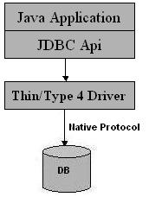
Type 4 JDBC Driver/Native-protocol/all-Java driver

Slide 34
Example for Type 4 driver
Thin Driver for oracle from Oracle Corporation
Weblogic, MSsql server4 for MS Sql server from BEA systems

Slide 35
JDBC Packages:
The JDBC API is contained in two packages
java.sql - Contains core java data objects of the JDBC API.
These include Java data objects that provide the basics for connecting to the DBMS & interacting with data stored in the DBMS. It is the part of J2SE.
2. javax.sql – is in the J2EE. Javax.sql package are java data objects that interact with Java Naming and Directory interface (JNDI) & java data objects that manage connection pooling among other advanced JDBC features
Shivakumara Tuppad, Asst. Professor, Dept. of MCA, BMSIT

Slide 36
The java.sql Package
The java.sql package is also known as the JDBC API.
This package includes the interfaces and method to perform JDBC core operations.
The classes in java.sql package can be categorized into:
Connection Management: cm
Database Access : da
Data Types : dt
Database Metadata : dm
Exceptions and Warnings : ew

Slide 37
Connection Management Class/Interfaces
Class/Interface
Java.sql.Connection
Java.sql.Driver
Java.sql.DriverManager
Database Access class/Interfaces
Class/Interface
Java.sql.Callable Statement
Java.sql.PreparedStatement
Java.sql.ResultSet
Java.sql.statement
Shivakumara Tuppad, Asst. Professor, Dept. of MCA, BMSIT

Slide 38
Data Types Class/Interfaces
Class/Interface
Java.sql.Blob
Java.sql.Clob
Java.sql.Types
Database Metadata Class/Intefaces
Class/Interface
Java.sql.DatabaseMetaData
Java.sql.ParameterMetaData
Java.sql.ResultSetMetaData
Exceptions and Warnings Class/Interfaces
Class/Interface
Java.sql.SQLException
Java.sql.SQLWarning
Shivakumara Tuppad, Asst. Professor, Dept. of MCA, BMSIT

Slide 39
The javax.sql Package
This API provides classes and interfaces for accessing server –side data sources & processing java programs.
The javax.sql provides the following features:
    DataSource
    Connection & Statement Pooling
    Distributed transaction
    Rowsets

Slide 40
Overview of the JDBC process
Basic JDBC Steps
  Loading the JDBC driver
  Connecting to the DBMS
  Creating and Executing a statement
  Processing data returned by the DBMS
  Terminating the connection with the DBMS

Slide 41
Basic JDBC Steps
Begin
Import the
java.sql package
2
Load and
Register the driver
3
Create a
Connection object
4
5
Create a
Statement object
6
Execute the
statement
Close Connection
of 23
End

Slide 42
Popular JDBC driver names and database URL.
RDBMS | JDBC Driver name | Database URL format
MySQL | com.mysql.jdbc.Driver | jdbc:mysql://hostname:3306/databaseName
ORACLE | oracle.jdbc.driver.OracleDriver | jdbc:oracle:thin:@hostname: port Number: databaseName
DB2 | COM.ibm.db2.jdbc.net.DB2Driver | jdbc:db2: hostname: portnumber/ databaseName
Sybase | com.sybase.jdbc.SybDriver | jdbc:sybase:Tds: hostname: portnumber/ databaseName

Slide 43
Database Connection:
A J2EE component does not directly connect
to a DBMS
The J2EE component connects with the JDBC
driver that is associated with the DBMS.
Before this connection is made, the JDBC driver
must be loaded and Registered with the
DriverManager.
Shivakumara Tuppad, Asst. Professor, Dept. of MCA, BMSIT

Slide 44
The purpose of loading and registering the JDBC driver is to bring the JDBC driver into the Java Virtual Machine (JVM).
The JDBC driver is automatically registered with the DriverManager once the JDBC driver is loaded and is therefore available to the JVM and can be used by J2EE components.
Shivakumara Tuppad, Asst. Professor, Dept. of MCA, BMSIT

Slide 45

Class.forName() method is used to load the JDBC driver.
The Class.forName() method throws a ClassNotFoundException if an error occurs when loading the JDBC driver.
Errors are trapped using the catch{} block whenever the JDBC driver is being loaded
Shivakumara Tuppad, Asst. Professor, Dept. of MCA, BMSIT

Slide 46
Cont..
Import the packages:
  import java.sql.*;
Load & Register the JDBC driver
  Class.forName( String URL); Listing 6-4
  eg: //mysql driver: "com.mysql.jdbc.Driver";
Establishing a Connection using DriverManager
  getConnection(String url, String username, String password)
  Syntax of url: jdbc:<sub prootcol> : <info>
  "jdbc:mysql://localhost:3306/STUDENTS";

Slide 47
The Connection:
After the jdbc driver is successfully loaded and registered, the J2EE component must connect to the database.
The data source that the JDBC component will connect to is defined using the URL format.
Shivakumara Tuppad, Asst. Professor, Dept. of MCA, BMSIT

Slide 48
URL consists of three parts.
  jdbc - which indicates that the JDBC protocol is to be used to read the URL.
  <suprotocol> - Which is the JDBC driver name.
  <subname> - Which is the name of the database
Shivakumara Tuppad, Asst. Professor, Dept. of MCA, BMSIT

Slide 49
The connection to the database is established by using one of the three getConnection() methods of the DriverManager object.
The getConnection() method requests access to the database from the DBMS.
It is up to the DBMS to grant or reject access.
A connection object is returned by the getConnection() method if access is granted, otherwise getConnection() method throws a SQLException.
Ex: Connection con = DriverManager.getConnection(Database url)
Shivakumara Tuppad, Asst. Professor, Dept. of MCA, BMSIT

Slide 50
Sometimes the DBMS grants access to a database to anyone. In this case, the J2EE component uses the getConnection(String url) method.
One parameter is passed to the method because the DBMS only needs the database identified.
Other databases limit access to authorized users and require the J2EE to supply a user ID and password with the request to access the database.
In this case, the J2EE component uses the getConnection(String url, String user, String password) method.
For ex: slide42
Shivakumara Tuppad, Asst. Professor, Dept. of MCA, BMSIT

Slide 51
Sometimes DBMS requires information besides a user Id and password before the DBMS grants access to the database.
This additional information is referred to as properties and must be associated with a Properties object , which is passed to the DBMS as a getConnection() parameter.
Typically, properties used to access a database are stored in a text file, the contents of which are defined by the DBMS manufacturer.
Shivakumara Tuppad, Asst. Professor, Dept. of MCA, BMSIT

Slide 52
The J2EE component uses a FileInputStream object to open the file and then uses the Properties object load() method to copy the properties into a Properties object.
For example:
Connection Db;
Properties props = new Properties();
try {
FileInputStream propFileStream = new fileInputStream(“DBProps.txt”);
props.load(propFileStream);
} catch(IOException e){……}
Shivakumara Tuppad, Asst. Professor, Dept. of MCA, BMSIT

Slide 53
try
{
Class.forName(com.mysql.jdbc.Driver);
Db=DriverManager.getConnection(url,props);
}
catch(ClassNotFoundException e) {……}
TimeOut:
Competition to use the same database is a common occurrence in the J2EE environment and can lead to performance degradation of a J2EE application.
Shivakumara Tuppad, Asst. Professor, Dept. of MCA, BMSIT

Slide 54
If the J2EE application that needs database access requests service from an appropriate J2EE component. In turn, the J2EE component attempts to connect to the database.
Due to various reasons, if j2ee component fails to connect to database, then the J2EE component can set a timeout period after which the DriverManager will cease to attempt to connect to the database.
The public static void DriverManager.setLoginTimeout(int seconds) method is used to retrieve from the DriverManager the maximum time the DriverManager is set to wait until it times out. And it returns an int that represents seconds
Shivakumara Tuppad, Asst. Professor, Dept. of MCA, BMSIT

Slide 55
Cont..
Creating a JDBC Statement Object
  Statement stmt=connection.createStatement();
Execute SQL Statements
//using executeQuery()
  String query = “select col1, col2…..coln from table_name";
  ResultSet results=stmt.executeQuery(query);
  // usng executeUpdate()
  String query=“insert into table_name values (value1, value2,……..valuen);
  Int count=stmt.executeUpdate(sql);
Closing the Connection
  Connection.close();

Slide 56
Accessing MySQL on NetBeans using JDBC
Requirements:
  MySQL Connector/J, licensed under the GPL or a commercial license from MySQL AB.
  NetBeans with JRE (Java Runtime Environment).
Step 1 Installation:
  Install NetBeans IDE 7.0.1 / 6.9.1 /…..
  Download MySQL Connector/J, name ‘mysql-connector-java-5.0.6.zip’
  Extract the zip file to a folder, you’ll see file ‘mysql-connector-java-5.0.6-bin.jar’
  Example to “C:\Program Files\Java\jdk1.6.0_02\lib” directory.

Slide 57
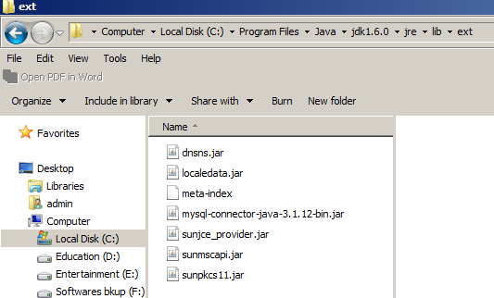
If you work with notepad/edit plus editors
Copy msql-connector.jar file into the following path:
Shivakumara Tuppad, Asst. Professor, Dept. of MCA, BMSIT

Slide 58
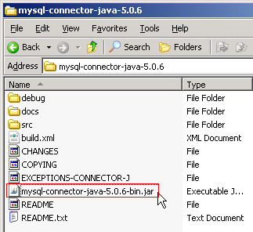
Cont…

Slide 59
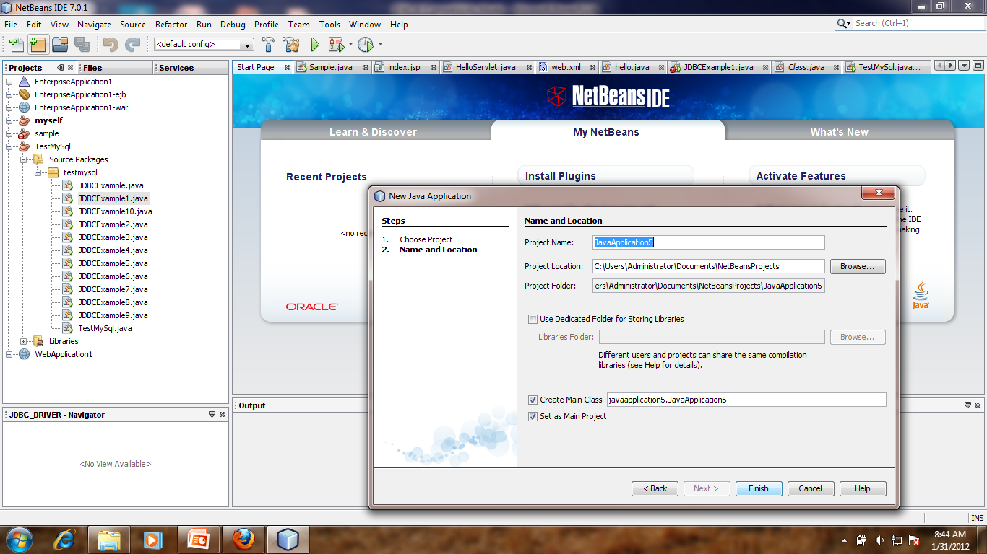
Cont…
Step 2: Add JDBC Driver to the project on NetBeans (Add a library).
  Create New Projetct

Slide 60
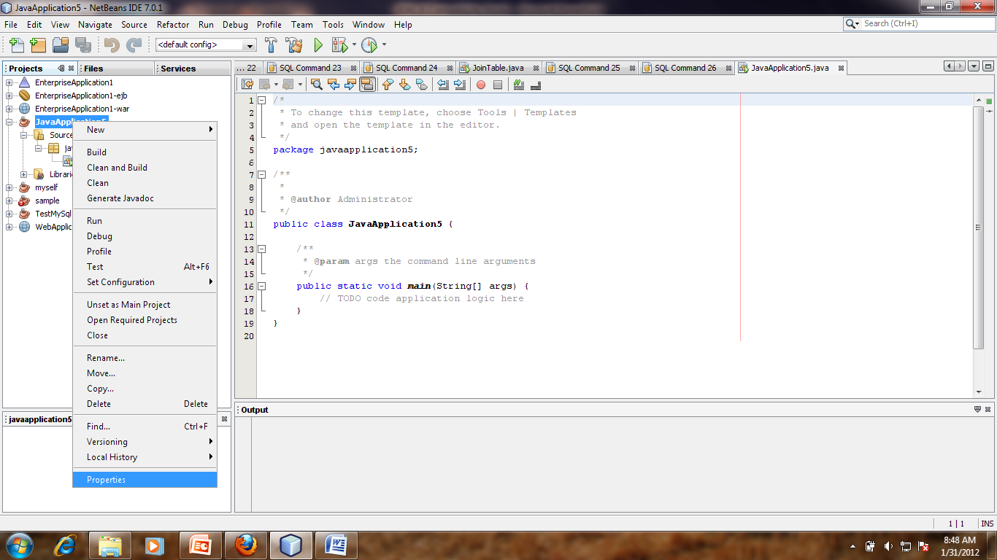
Cont…
2. In Projects window, right click the project name and select Properties.

Slide 61
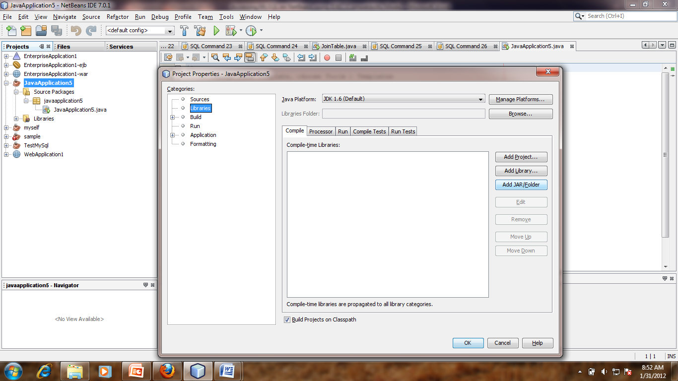
3. Project Properties window appears. The Categories on left side, select Libraries. And on right side in Compile tab, click Add JAR/Folder.

Slide 62
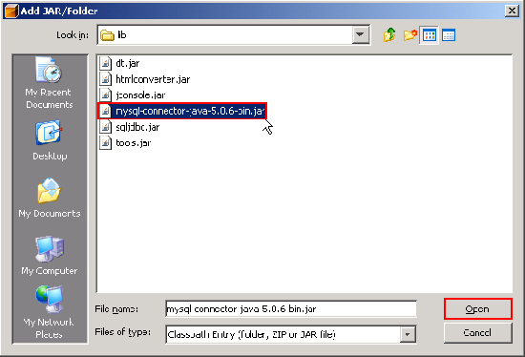
Cont…
4. New Window appears, browse to the file ‘mysql-connector-java-5.0.6-bin.jar’ and click Open.

Slide 63
Creating a simple JDBC Application
Obtaining the connection
Get the utility objects, such as Statement, PreparedStatement and CallableStatement to execute SQL Statements
Execute the required SQL Statements
Close the connection

Slide 64
package studentdb;
import java.sql.*;
public class studentdb{
private Connection con;
private Statement st;
// private ResultSet rs;
public studentdb()
{
String url = "jdbc:mysql://localhost:3306/studentdb";
String userID = "root";
String password = "root";
try {
Class.forName( "com.mysql.jdbc.Driver");
con = DriverManager.getConnection(url,userID,password);
}
catch (ClassNotFoundException error) {
System.err.println("Unable to load the MySql Driver" + error);
System.exit(1);
}

Slide 65
catch (SQLException error) {
System.err.println("Cannot connect to the database." + error);
System.exit(2);
}
try
{ //Enter Example Code Here (like create, insert, delete, update, view, index, drop, join etc...........
String query1;
query1 = "CREATE TABLE studenttable ("+
"regno char(11),"+
"name char(50)," +
"sem char(1)," +
"percent char(3))";
st = con.createStatement();
st.execute(query1);
con.close();
}

Slide 66
catch ( SQLException error )
{
System.err.println("SQL error." + error);
}
}
public static void main ( String args [] )
{
final studentdb sql1 = new studentdb ();
System.exit ( 0 ) ;
}
}

Slide 67
Connection Pool:
Connecting to a database is performed on a per-client
basis.
Each client must open its own connection to a database
and the connection cannot be shared with unrelated clients.
Leaving a connection open might prevent another client
from accessing the database should the DBMS have
available a limited number of connections.
Connecting and re-connecting is simply time-consuming
and cause performance degradation.

Slide 68
A connection pool is a collection of database connections
that are opened once and loaded into memory so these
connections can be reused without having to reconnect
to the DBMS.
Clients use the DataSource interface to interact with the
Connection pool. The connection pool itself is implemented
By the application server, which hides from the client details
On how the connection pool is maintained.
There are two types of connections made to the database
Physical connection.
Logical connection

Slide 69
The physical connection, which is made by the application
Server using PooledConnection objects.
PooledConnection objects are cached and reused.
A logical connection is made by a client calling the
DataSource.getConnection() method, which connects to a
PooledConection object that already has a physical
Connection to the database. For ex:
Context ctext = new InitialContext();
DataSource pool = (DataSource) ctext.lookup(“
java:comp/env/jdbc/pool”);
Connection db = pool.getConnection();
//place code to interact with the database here
db.close();

Slide 70
Statement Objects:
Once a connection to the database is opened, the J2EE
Component creates and sends a query to access data
Contained in the database. The query is written using SQL.
One of three types of statement objects is used to execute
The query. These objects are:
Statement: Which executes a query immediately
PreparedStatement: Which is used to execute a
compiled query
3. CallableStatement: Which is used to execute store
procedures.

Slide 71
Statement Object:
It is used whenever a J2EE component needs to
Immediately execute a query without first having the
Query compiled.
It contains the executeQuery() method, which is passed
The query as an argument. The query then transmitted
To the DBMS for processing.
The executeQuery() method returns one ResultSet
Object that contains rows, columns, and metadata that
Represent data requested by query.
The ResultSet object also contains methods that are used
To manipulate Setdata in the Result.

Slide 72

The execute() method of the statement object is used when
There may be multiple results returned.
The executeUpdate() method is used to execute queries
That contain UPDATE and DELETE SQL statements,
Which changes values in a row and removes a row
Respectively.
The executeUpdate() method returns an integer indicating
The number of rows that were updated by the query.

Slide 73

The executeUpdate() is used to INSERT, UPDATE,
DELETE, and DDL statements.
The createStatement() method of the Connection object is
Called to return a Statement object.
The following example illustrate how to use the
executeUpdate() method of the Statement object.

Slide 74
PreparedStatement Object:
A SQL query must be compiled before the DBMS
Processes the query. Compiling occurs after one of the
Statemtent Object’s execution methods is called.
Compiling a query is an overhead that is acceptable if
The query is called once.
However, the compiling process can become an expensive
Overhead if the query is executed several times by the
Same instance of the J2EE component during the same
Session.

Slide 75
A query can be precompiled and executed by using the
PreparedStatement object.
However, a question mark is used as a placeholder for a
Value that is inserted into the query after the query is
Compiled.
It is this value that changes each time the query is executed.
The preparedStatement() method of the Connection object is
Called to return the PreparedStatement object.
The preparedStatement() method is passed the query, which
Is then precompiled.

Slide 76

The setXXX() method of the PreparedStatement object is
Used to replace the question mark with the value passed
To the setXXX() method.
XXX represents the data types of the value that is being
Passed to the setXXX() method.
The setXXX() requires two parameters.
The first parameter is an integer that identifies the position
Of the question mark placeholder and the second
Parameter is the value that replaces the question mark
Placeholder.

Slide 77
The advantage of using the PreparedStatement object is
That the query is precompiled once and the setxxx()
Method called as needed to change the specified values
Of the query without having to recompile the query.
The PreparedStatement object also has an execute() &
executeUpdate() method.
The precompiling is performed by the DBMS and is
Referred to as “late binding” . When the DBMS receives
The request, the DBMS attempts to match the query to
A previously compiled query. If found, then parameters
Passed to the query using the setxxx() methods are
Bound and the query is executed.

Slide 78
If not found, then the query is compiled and retrained by
The DBMS for later use.
The JDBC driver passes two parameters to the DBMS.
1. One parameter is the query and
2. the other is an array of late binding variables.
Both binding and compiling is performed by the DBMS.
The late binding is not associated with the specific object
Or code block where the preparedStatement() is
Declared.

Slide 79
Callable Statement:
The CallableStatement object is used to call a stored
Procedure from within a J2EE object.
The stored procedure is executed by invoking the name of
The stored procedure.
The callableStatement object uses three types of
Parameters when calling a stored procedure.
IN
OUT
INOUT

Slide 80

The IN parameter contains any data that needs to be
Passed to the stored procedure and whose value is
Assigned using the setxxx() method.
The OUT parameter contains the value returned by the
Stored procedures, if any.
The OUT parameter must be registered using the
registerOutParameter() method and then is later retrieved
By the J2EE component using the getxxx() method.
The INOUT parameter is a single parameter that is used
To both pass information to the stored procedure. And
Retrieve information from a stored procedure.

Slide 81
ResultSet:
A query is used to update, delete, and retrieve information
Stored in a database.
The executeQuery() method is used to send the query to
The DBMS for processing and returns a ResultSet object
That contains data that was requested by the query.
The ResultSet object contains methods that are used to
Copy data from the ResultSet into a java collection object
Or variable for further processing.
Data in a ResultSet object is logically organized into a
Virtual table consisting of rows and columns.

Slide 82
In addition to data, the ResultSet object also contains
Metadata such as column names, column size, and
Column data type.
The ResultSet uses a virtual cursor to point to a row of
The virtual table.
A J2EE component must move the virtual cursor to each
Row and then use other methods of the ResultSet object
To interact with the data stored in columns of that row.
A virtual cursor is positioned above the first row of data
When the ResultSet is returned by the executeQuery()
Method.

Slide 83

The virtual cursor is positioned above the first row of data when the ResultSet is returned by the executeQuery() method.
The virtual cursor is moved to the first row using the next() method.
The next() method returns a boolean true if the row contains data; otherwise, a boolean false is returned indicating that no more rows exist in the ResultSet.

Slide 84
Scrollable ResultSet:
Until the release of the JDBC 2.1 API, the virtual cursor could only be moved down the ResultSet object.
But, today, the virtual cursor can be moved backwards or even positioned at a specific row.
There are six methods of the ResultSet object that are used to position the virtual cursor in addition to the next() method. These are
1. first() 2. last() 3. previous() 4. absolute()
5. relative(), and 6. getRow().

Slide 85
The first() method moves the virtual cursor to the first row in the ResultSet.
The last() method moves the virtual cursor to the last row in the ResultSet.
The previous() method moves the virtual cursor to the previous row from the current position.
The absolute() method positions the virtual cursor at the row number specified by the integer passed as a parameter to the absolute() method.

Slide 86
The relative() method moves the virtual cursor the specified number of rows contained in the parameter.
The parameter is a positive or negative integer where the sign represents the direction the virtual cursor is moved.
For ex: -4 moves the virtual cursor back four rows from the current row.
And the getRow() method returns an integer that represents the number of the current row in the ResultSet.

Slide 87
The statement object that is created using the createStatement() of the Connection object must be set up to handle a scrollable ResultSet by passing the createStatement() method one of three constants.
St = con.createStatement(TYPE_FORWARD_ONLY)
TYPE_FORWARD_ONLY: constant restricts the virtual cursor to downward movement, which is the default setting.
2. TYPE_SCROLL_INSENSITIVE: constant makes the ResultSet insensitive to changes made by another J2EE component to data in the table whose rows are reflected in the ResultSet

Slide 88

3. TYPE_SCROLL_SENSITIVE: constant makes the ResultSet sensitive to those changes.
The above two constants permit the virtual cursor to move in both directions.
Note: Not all JDBC Drivers are Scrollable

Slide 89
UPDATABLE RESULTSET:
Rows contained in the ResultSet can be updatable similar to how rows in a table can be updated.
This is made possible by passing the createStatement() method of the Connection object the CONCUR_UPDATABLE.
Statement st = con.createStatement(CONCUR_UPDATABLE)
Alternatively, the CONCUR_READ_ONLY constant can be passed to the createStatement() method to prevent the ResultSet from being updated.
Three ways in which a ResultSet can be changed.
Shivakumara Tuppad, Asst. Professor, Dept. of MCA, BMSIT

Slide 90
Updating values in a row
Deleting a row
Inserting a new row.
All these changes are accomplished by using methods of the Statement object.
Update ResultSet:
String qry=“select * from customers”;
Statement st = con.createStatement();
ResultSet rs = st.executeQuery(qry);
C_fname=“skt”
Once the executeQuery() method of the Statement object returns a ResultSet, the updatexxx() method is used to change the value of a column in the current row of the ResultSet.
XXX is replaced with the data type of the column that is to be updated.
Shivakumara Tuppad, Asst. Professor, Dept. of MCA, BMSIT

Slide 91
The updatexxx() method requires two parameters.
Either the number or name of the column of the ResultSet that is being updated.
Second parameter is the value that will replace the value in the column of the ResultSet.
Example: updateString(“c_fname”,”skt”)
A value in a column of the ResultSet can be replaced with a NULL value by using the updateNull() method.
Ex: updateNull(2)
updateNull() method requires one parameter, which is the number of column in the current row of the ResultSet.
Note: The updateNull() doesn’t accept the name of the column as a parameter.
Shivakumara Tuppad, Asst. Professor, Dept. of MCA, BMSIT

Slide 92

The updateRow() method is called after all the updatexxx() methods are called.
The updateRow() method changes values in columns of the current row of the ResultSet based on the values of the updatexxx() methods.
C_fname | C_lastname | Balance | Paid status | Contact_no
shiva | T | 2000 | No | 8888888888
Skt | R | 0 | Yes | 4949494949
Delete Row in the ResultSet:
The deleteRow() method is used to remove a row from a ResultSet.
The deleteRow() method is passed an integer that contains the number of the row to be deleted.
Results.deleteRow(0); - Deletes the current row
Shivakumara Tuppad, Asst. Professor, Dept. of MCA, BMSIT

Slide 93

Insert Row in the ResultSet:
Inserting a row into the ResultSet is accomplished using basically the same technique as is used to update the ResultSet.
The insertRow() method is called after the updatexxx() methods, which causes a new row to be inserted into the ResultSet having values that reflect the parameters in the updatexxx() methods. This also updates the underlying database
Shivakumara Tuppad, Asst. Professor, Dept. of MCA, BMSIT

Slide 94

Transaction Processing:
A database transaction isn’t completed until the J2EE component calls the commit() method of the Connection object.
Note: commit() method was automatically called in these examples because the DBMS has an AutoCommit feature that is by default set to true.
Shivakumara Tuppad, Asst. Professor, Dept. of MCA, BMSIT

Slide 95

J2EE component can control the number of tasks that are rolled back by using savepoints.
A savepoint, introduced in JDBC 3.0, is a virtual marker that defines the task at which the rollback stops.
setSavepoint(savepoint_name) is used to set the savepoint.
releaseSavepoint() method is called to remove the savepoint from the transaction. The name of the savepoint that is to be removed is passed to the releaseSavepoint() method.
Shivakumara Tuppad, Asst. Professor, Dept. of MCA, BMSIT

Slide 96
Batch Transaction:
Another way to combine SQL statements into a transaction is to batch together these statements into a single transaction and then execute the entire transaction.
By using the addBatch() method of the Statement object.
addBatch() method receives a SQL statement as a parameter and places the SQL statement in the batch.
Once all the SQL statements that comprise the transaction are included in the Batch, the executeBatch() method returns an int array that contains the number of SQL statements that were executed successfully.
Shivakumara Tuppad, Asst. Professor, Dept. of MCA, BMSIT

Slide 97

The batch can be cleared of SQL statements by using the clearBatch() method.
The transaction must be committed using the commit() method.
Note: Make sure that setAutoCommit() is set to false before executing the batch.
Shivakumara Tuppad, Asst. Professor, Dept. of MCA, BMSIT

Slide 98
ResultSet Holdability:
Whenever the commit() method is called, all ResultSet objects that were created for the transaction are closed.
Sometimes, a J2EE component needs to keep the ResultSet open even after the commit() method is called.
We can control whether or not ResultSet objects are closed following the call to the commit() method by passing one of two constants to the createStatement() method.
Shivakumara Tuppad, Asst. Professor, Dept. of MCA, BMSIT

Slide 99
These constants are
ex: Statement st = con.createStatement(CLOSE_CURSORS_AT_COMMIT )
HOLD_CURSORS_OVER_COMMIT and
CLOSE_CURSORS_AT_COMMIT
The first one constant keeps ResultSet objects open following a call to the commit() method
Second one, closes ResultSet objects when the commit() method is called.
Shivakumara Tuppad, Asst. Professor, Dept. of MCA, BMSIT

Slide 100
RowSets:
The JDBC RowSets object is used to encapsulate a ResultSet for use with Enterprise Java Beans.
A RowSet object contains rows of data from a table(s) that can be used in a disconnected operation.
Ie., an EJB can interact with a RowSet object without having to be connected to a DBMS, which is ideal for J2EE components that have PDA clients.
Shivakumara Tuppad, Asst. Professor, Dept. of MCA, BMSIT

Slide 101
Auto-Generated Keys:
It is common for a DBMS to automatically generate unique keys for a table as rows are inserted into the table.
The getGeneratedKeys() method of the Statement object is called to return keys generated by the DBMS.
This method returns a ResultSet object. You can use the ResultSet.getMetaData() method to retrieve metadata relating to the automatically generated key, such as the type and properties of the automatically generated key.
Shivakumara Tuppad, Asst. Professor, Dept. of MCA, BMSIT

Slide 102
Metadata:
Metadata is data about data. A J2EE component can access metadata by using the DatabaseMetaData interface.
This interface is used to retrieve information about databases, tables, columns, and indexes among other information about the DBMS.
A J2EE component retrieves metadata about the database by calling the getMetaData() method of the Connection object.
Shivakumara Tuppad, Asst. Professor, Dept. of MCA, BMSIT

Slide 103
The getMetaData() method returns a DatabaseMetaData object that contains information about the database and its components.
Once the DatabaseMetaData object is obtained, an assortment of methods contained in the DatabaseMetaData object are called to retrieve specific metadata.
Some of the more commonly used DatabaseMetaData object methods.
getDatabaseProductName() – Returns the product name of the database.
getUserName() – Returns the username
getURL () – Returns the URL of the database
getSchemas() – Returns all the schema names available in this database.
getPrimaryKeys() – Returns primary keys.
getProcedures() – Returns stored procedure names.
getTables() – Returns names of tables in the database.
Shivakumara Tuppad, Asst. Professor, Dept. of MCA, BMSIT

Slide 104
ResultSet MetaData:
There are two types of metadata that can be retrieved from the DBMS.
These are
metadata that describes the database
Metadata that describes the ResultSet.
Metadata that describes the ResultSet is retrieved by calling the getMetaData() method of the ResultSet object.
This returns a ResultSetMetaData object,
ResultSetMetaData rm=Result.getMetaData()
Shivakumara Tuppad, Asst. Professor, Dept. of MCA, BMSIT

Slide 105
Once the ResultSet metadata is retrieved, the J2EE can call methods of the ResultSetMetaData (rsmd) object to retrieve specific kinds of metadata.
Rsmd.getColumnCount() = 4
getColumnCount() – Returns the number of columns contained in the ResultSet.
Rsmd.getColumnName(4)
2. getColumnName(int number) – Returns the name of the column specified by the column number.
Rsmd.getColumnType(2)
3. getColumnType(int number) – Returns the data type of the column specified by the column number.
Shivakumara Tuppad, Asst. Professor, Dept. of MCA, BMSIT

Slide 106
Data Types
The setxxx() amd getxxx() methods are used to set a value of a specific data type and to retrieve a value of a specific data type.
The xxx in the names of these methods is replaced with the name of the data type.
Shivakumara Tuppad, Asst. Professor, Dept. of MCA, BMSIT

Slide 107
Data Types in Java
SQL Type | Java Type
CHAR | String
VARCHAR | String
LONGVARCHAR | String
NUMERIC | Java.math.BigDecimal
DECIMAL | Java.math.BigDecimal
BIT | Boolean
TINYINT | Byte
SMALLINT | Short
INTEGER | Integer
BIGINT | Long
REAL | float
FLOAT | float
DOUBLE | double
Shivakumara Tuppad, Asst. Professor, Dept. of MCA, BMSIT

Slide 108
Data Types in Java
SQL Type | Java Type
BINARY | Byte[ ]
VARBINARY | Byte[ ]
LONGVARBINARY | Byte[ ]
BLOB | java.sql.Blob
CLOB | java.sql.Clob
ARRAY | java.sql.Array
STRUCT | java.sql.Struct
REF | java.sql.Ref
DATALINK | java.sql.Types
DATE | java.sql.date
TIME | java.sql.Time
TIMESTAMP | java.sql.Timestamp
Shivakumara Tuppad, Asst. Professor, Dept. of MCA, BMSIT

Slide 109
Exceptions:
There are three kinds of exceptions that are thrown by JDBC methods.
SQLExceptions – commonly reflects a SQL syntax error in the query & are thrown by many of the methods contained in the java.sql.package.
The getNextException() method of the SQLExceptions object is used to return details about the SQL error or null if the last exception was retrieved.
The getErrorCode() method of the SQLException object is used to retrieve vendor-specific error codes.
Shivakumara Tuppad, Asst. Professor, Dept. of MCA, BMSIT

Slide 110
SQLWarnings – throws warnings received by the Connection from the DBMS.
getWarnings() method of the Connection object retrieves the warning and the getNextWarning() method of the connection object retrieves subsequent warnings.
3. Data Truncation – Whenever data is lost due to transaction of the data value, a DataTruncation exception is thrown.
Shivakumara Tuppad, Asst. Professor, Dept. of MCA, BMSIT

Slide 111
SUMMARY:
JDBC SPECIFICATION
JDBC DRIVER TYPES
JDBC PACKAGES
JDBC PROCESS
DATABASE CONNECTION
CONNECTION POOL
STATEMENT OBJECTS
RESULT SET
UPDATABLE RESULTSET
TRANSACTION PROCESSING
METADATA
DATA TYPES
EXCEPTIONS
Shivakumara Tuppad, Asst. Professor, Dept. of MCA, BMSIT

Slide 112
References
Java Complete Reference text book, Herbert Schedilt
Java Programming, Black Book
Enterprise Java Beans 3.1

